Slide 1

Kovarna
Seeking over $15 billion in funding
Don’t worry, it’ll be good
But absolutely no guarantees
(I don’t want to get sued)
But if I do, I’ll have enough money!
By: Karter Ence

Slide 2
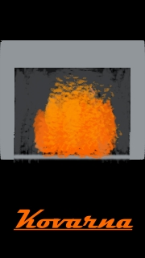
Box Artwork
Get it? “Kovarna” means “forge” in Czech, and the box art depicts a forge! Crazy!

Slide 3
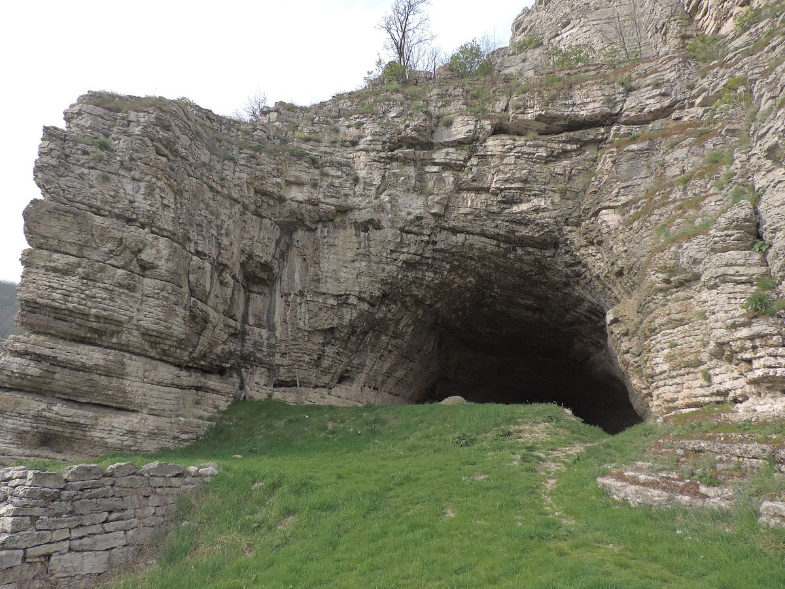
Synopsis
At the beginning of the game, you start out with a simple knife and no armor
Wolves begin to attack you as you move forward
After encountering the wolves, you find a cave and move through it
The cave contains puzzles. After solving them, you find a forge and a chest with some items to build a sword
Upon exiting the cave, you see a town in the distance
In the town, you meet some people that help you get healed and provide you with some food and simple armor
This Photo by Unknown Author is licensed under CC BY-SA

Slide 4


Goal
In order to complete the game, you must venture out and find the Emerald Dungeon! But don’t let that confuse you, because the walls are actually made of LEGO bricks coated in gold for some reason! In this dungeon, the red dragon (who is actually blue) must be defeated. Progression is based on your ability to find items in towers, dungeons, and caves. These items can be combined with other items of a similar type in order to create the most powerful weapons and armor you can.
This Photo by Unknown Author is licensed under CC BY-SA-NC

Slide 5
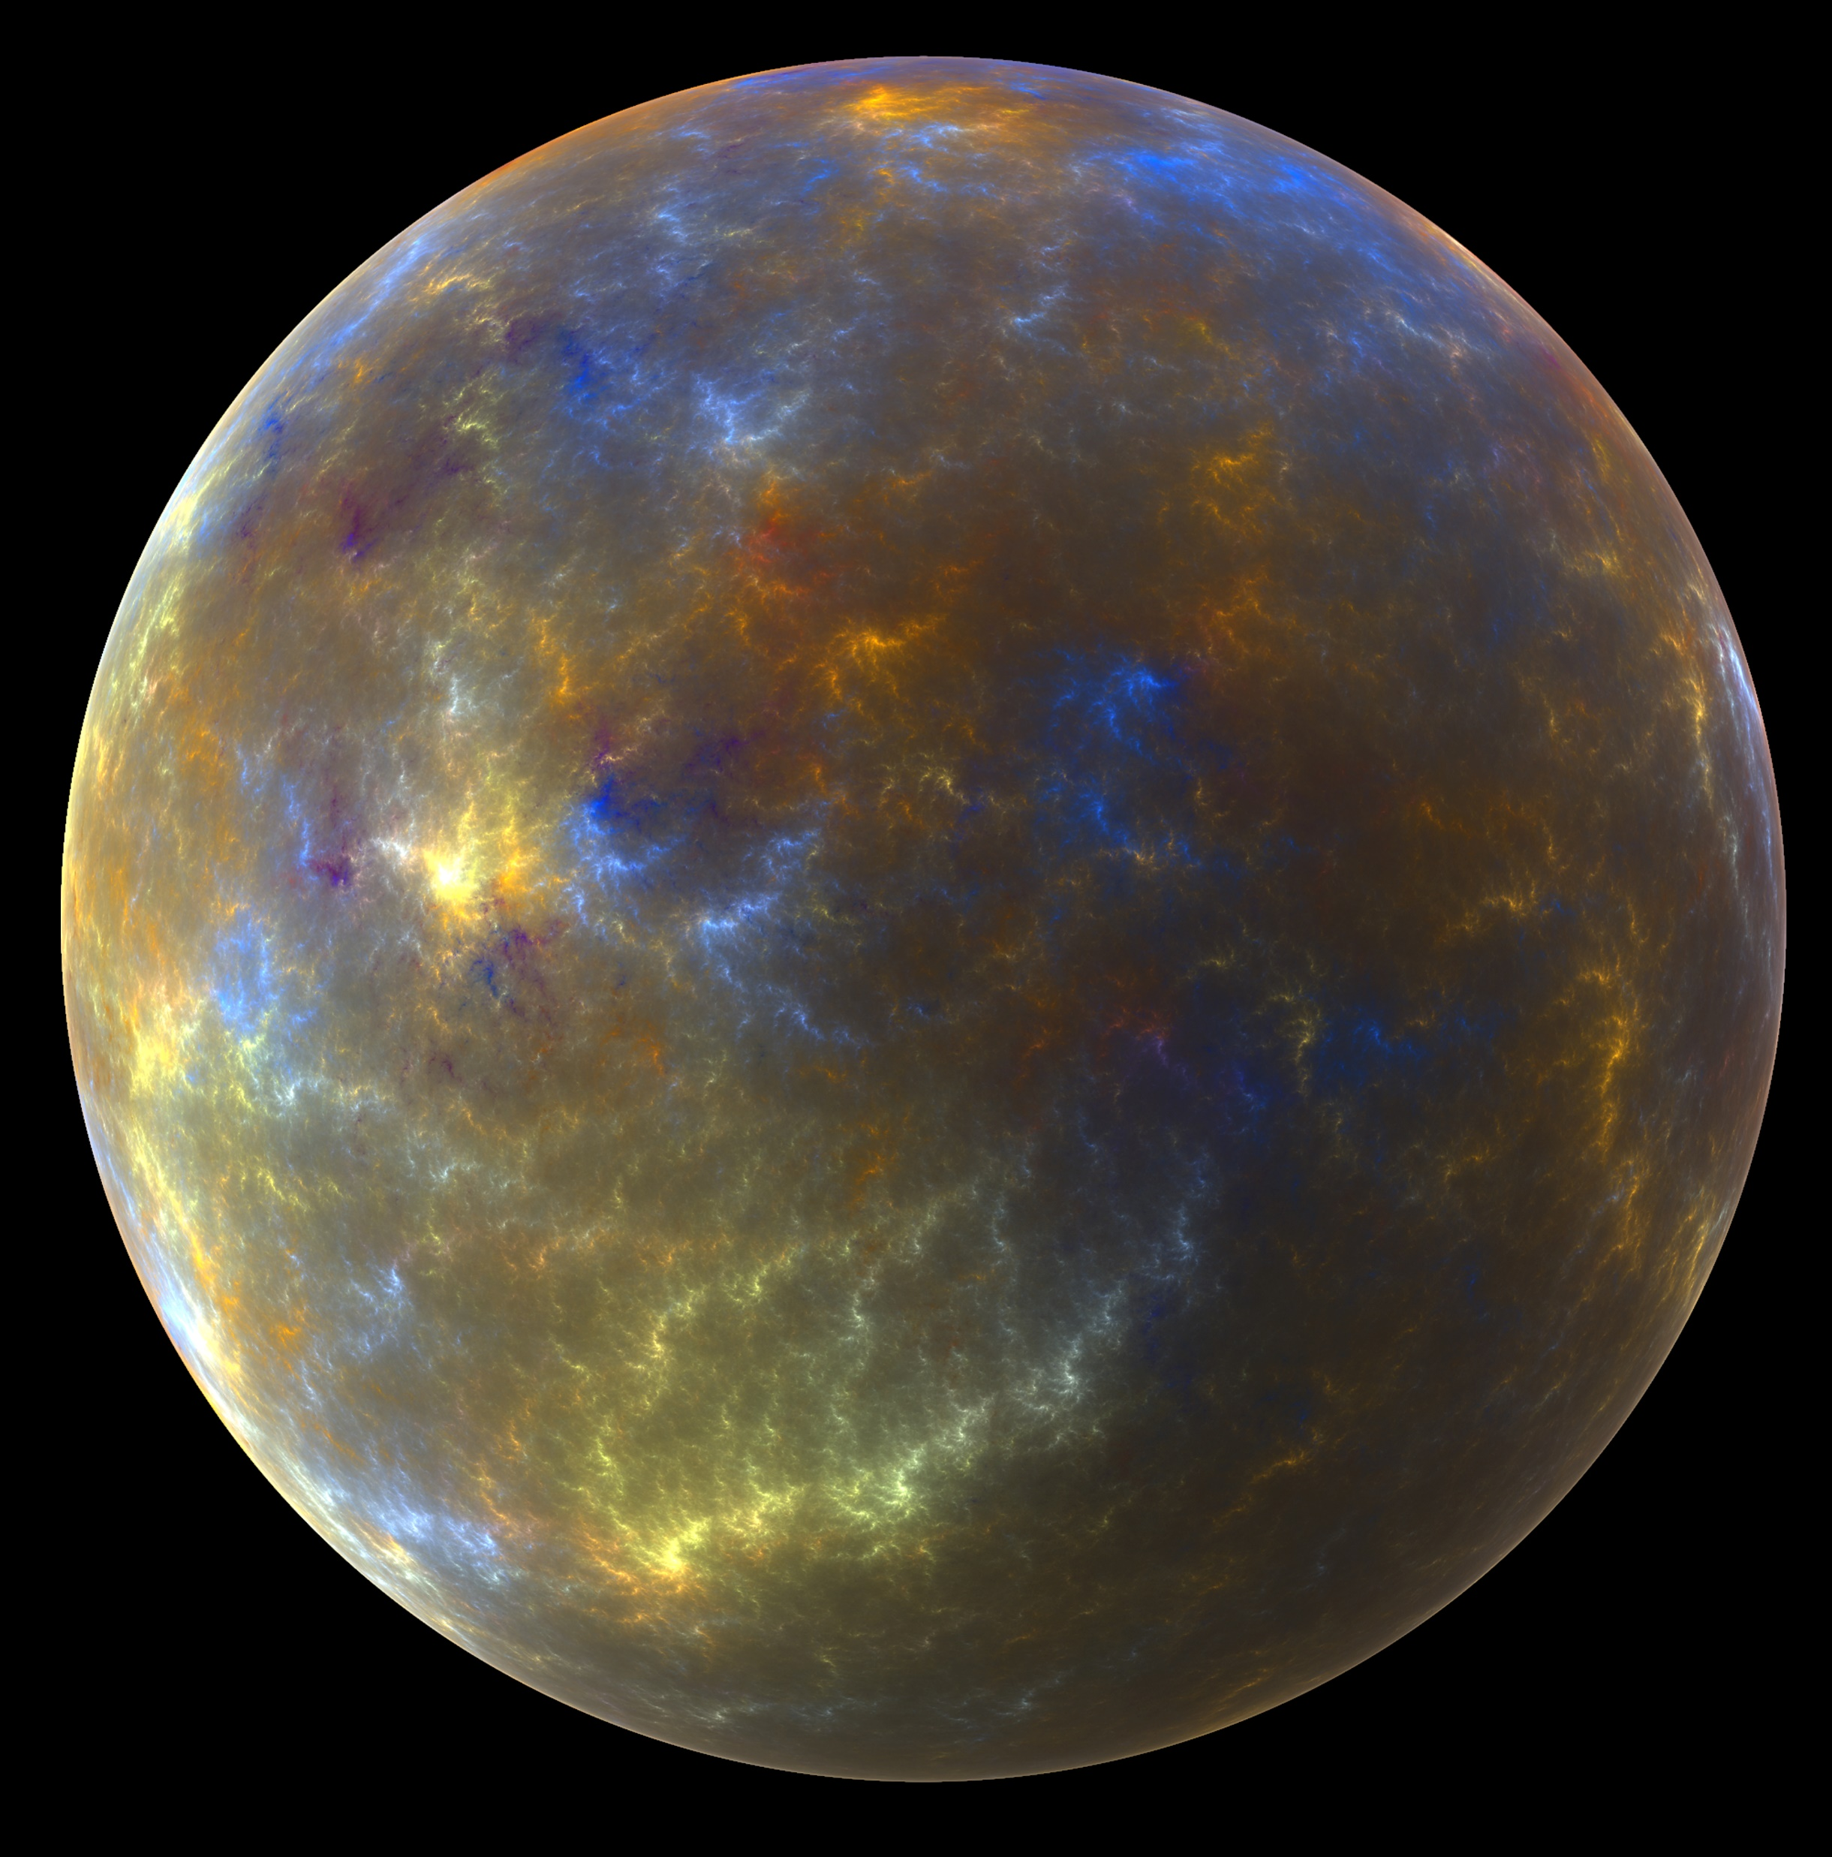
The Plot
You wake up and have no recollection of who you are. As you progress through the game, there is more revealed about yourself. You find out that you were sent from a different planet and put into cryosleep for the duration of the trip. However, the ship crash landed and ejected its passengers before destroying itself. You were the only survivor. There is no way for you to return home, as this planet has far inferior technology (similar to medieval times).
This Photo by Unknown Author is licensed under CC BY-NC

Slide 6

Main Characters
Protagonist
An engineer from Earth
Sent with a crew to settle a new planet
Creates new inventions with the materials available to him
Antagonist
Formidable dragon named “Zenidor”
Threatens civilizations worldwide
Hundreds of years old
Has watched the player since the beginning of the game
This Photo by Unknown Author is licensed under CC BY-SA-NC
This Photo by Unknown Author is licensed under CC BY-NC

Slide 7
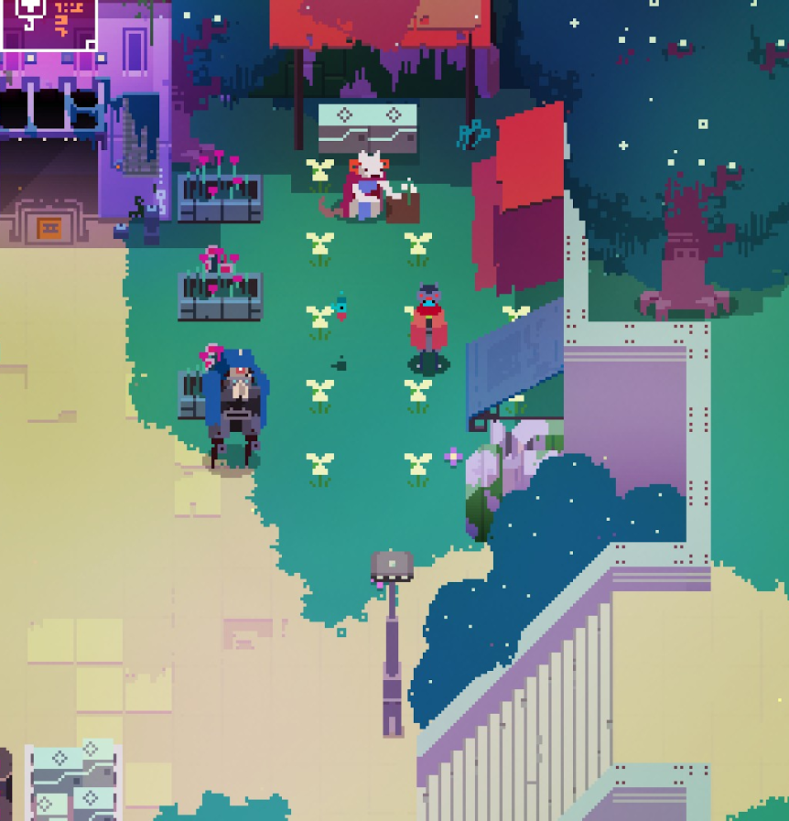
Environment
Takes place on an Earth-like planet with similar technology and developments as the dark ages
Similar art and gameplay style to Hyper Light Drifter
Enemies of varying strengths placed throughout the game
Enemies get more difficult the further the player progresses
The player will encounter puzzles that give the player a break after participating in combat
The game will start out in a forest and take the player through caves, towns, plains, beaches, and oceans
This Photo by Unknown Author is licensed under CC BY-SA

Slide 8
Engine
I would prefer to use Unity as it is relatively simple to use while still offering many incredible features to take advantage of. I would also like to use it because it uses C# and can take advantage of everything available to that language.

